Slide 1
The Life of Christ
Review Of The Course

Slide 2
Review: A Second Group of Parables
The Strait Gate. Warned Against Herod (Luke 13:22-35)
Dining with a Pharisee, Sabbath Healing, and Three Lessons Suggested by the Event (Luke 14:1-24)
Cost of Discipleship Must Be Counted (Luke 14:25-35)
The Parables of the Lost Sheep, Lost Coin, and Lost Son
(Luke 15:1-32)
The Parable of the Unrighteous Steward (Luke 16:1-18)
The Rich Man and Lazarus (Luke 16:19-31)
Concerning Offenses, Faith, and Service (Luke 17:1-10)
Notes:
Luke 13:22-35 – “1 He went on his way through towns and villages, teaching and journeying toward Jerusalem. 23 And someone said to him, ‘Lord, will those who are saved be few?’ And he said to them, 24 ‘Strive to enter through the narrow door ...
Matthew 7:13-14 – “13 Enter by the narrow gate. For the gate is wide and the way is easy that leads to destruction, and those who enter by it are many. 14 For the gate is narrow and the way is hard that leads to life, and those who find it are few.”
For many, I tell you, will seek to enter and will not be able ...
Hebrews 4:1-7 – “1 Therefore, while the promise of entering his rest still stands, let us fear lest any of you should seem to have failed to reach it. 2 For good news came to us just as to them, but the message they heard did not benefit them, because they were not united by faith with those who listened. 3 For we who have believed enter that rest, as he has said, ‘As I swore in my wrath, “They shall not enter my rest,”’ although his works were finished from the foundation of the world. 4 For he has somewhere spoken of the seventh day in this way: ‘And God rested on the seventh day from all his works.’ 5 And again in this passage he said, ‘They shall not enter my rest.’ 6 Since therefore it remains for some to enter it, and those who formerly received the good news failed to enter because of disobedience, 7 again he appoints a certain day, ‘Today,’ saying through David so long afterward, in the words already quoted, ‘Today, if you hear his voice, do not harden your hearts.’"
25 When once the master of the house has risen and shut the door, and you begin to stand outside and to knock at the door, saying, “Lord, open to us,” then he will answer you, “I do not know where you come from.” 26 Then you will begin to say, “We ate and drank in your presence, and you taught in our streets.” 27 But he will say, “I tell you, I do not know where you come from. Depart from me, all you workers of evil!”
John 10:1-29 (from two slides back) – turn to it.
Matthew 25:1-13 – turn to it.
28 In that place there will be weeping and gnashing of teeth, when you see Abraham and Isaac and Jacob and all the prophets in the kingdom of God but you yourselves cast out. 29 And people will come from east and west, and from north and south, and recline at table in the kingdom of God. 30 And behold, some are last who will be first, and some are first who will be last. 31 At that very hour some Pharisees came and said to him, ‘Get away from here, for Herod wants to kill you.’ 32 And he said to them, ‘Go and tell that fox, “Behold, I cast out demons and perform cures today and tomorrow, and the third day I finish my course. 33 Nevertheless, I must go on my way today and tomorrow and the day following, for it cannot be that a prophet should perish away from Jerusalem.”' 34 O Jerusalem, Jerusalem, the city that kills the prophets and stones those who are sent to it! How often would I have gathered your children together as a hen gathers her brood under her wings, and you would not! 35 Behold, your house is forsaken. And I tell you, you will not see me until you say, 'Blessed is he who comes in the name of the Lord!’”
cf. Matthew 23:37-39 – 37 O Jerusalem, Jerusalem, the city that kills the prophets and stones those who are sent to it! How often would I have gathered your children together as a hen gathers her brood under her wings, and you would not! 38 See, your house is left to you desolate. 39 For I tell you, you will not see me again, until you say, 'Blessed is he who comes in the name of the Lord.'"
Luke 14:1-24 – “1 One Sabbath, when he went to dine at the house of a ruler of the Pharisees, they were watching him carefully. 2 And behold, there was a man before him who had dropsy. 3 And Jesus responded to the lawyers and Pharisees, saying, ‘Is it lawful to heal on the Sabbath, or not?’ 4 But they remained silent. Then he took him and healed him and sent him away. 5 And he said to them, ‘Which of you, having a son or an ox that has fallen into a well on a Sabbath day, will not immediately pull him out?’ 6 And they could not reply to these things. 7 Now he told a parable to those who were invited, when he noticed how they chose the places of honor, saying to them, 8 ‘When you are invited by someone to a wedding feast, do not sit down in a place of honor, lest someone more distinguished than you be invited by him, 9 and he who invited you both will come and say to you, “Give your place to this person,” and then you will begin with shame to take the lowest place. 10 But when you are invited, go and sit in the lowest place, so that when your host comes he may say to you, “Friend, move up higher.” Then you will be honored in the presence of all who sit at table with you. 11 For everyone who exalts himself will be humbled, and he who humbles himself will be exalted.’ 12 He said also to the man who had invited him, ‘When you give a dinner or a banquet, do not invite your friends or your brothers or your relatives or rich neighbors, lest they also invite you in return and you be repaid. 13 But when you give a feast, invite the poor, the crippled, the lame, the blind, 14 and you will be blessed, because they cannot repay you. You will be repaid at the resurrection of the just.’ 15 When one of those who reclined at table with him heard these things, he said to him, ‘Blessed is everyone who will eat bread in the kingdom of God!’ 16 But he said to him, ‘A man once gave a great banquet and invited many. 17 And at the time for the banquet he sent his servant to say to those who had been invited, “Come, for everything is now ready.” 18 But they all alike began to make excuses. The first said to him, “I have bought a field, and I must go out and see it. Please have me excused.” 19 And another said, “I have bought five yoke of oxen, and I go to examine them. Please have me excused.” 20 And another said, “I have married a wife, and therefore I cannot come.” 21 So the servant came and reported these things to his master. Then the master of the house became angry and said to his servant, “Go out quickly to the streets and lanes of the city, and bring in the poor and crippled and blind and lame.” 22 And the servant said, “Sir, what you commanded has been done, and still there is room.” 23 And the master said to the servant, “Go out to the highways and hedges and compel people to come in, that my house may be filled. 24 For I tell you, none of those men who were invited shall taste my banquet.“’”
Luke 14:25-35 – “25 Now great crowds accompanied him, and he turned and said to them, 26 ‘If anyone comes to me and does not hate his own father and mother and wife and children and brothers and sisters, yes, and even his own life, he cannot be my disciple. 27 Whoever does not bear his own cross and come after me cannot be my disciple. 28 For which of you, desiring to build a tower, does not first sit down and count the cost, whether he has enough to complete it? 29 Otherwise, when he has laid a foundation and is not able to finish, all who see it begin to mock him, 30 saying, “This man began to build and was not able to finish.” 31 Or what king, going out to encounter another king in war, will not sit down first and deliberate whether he is able with ten thousand to meet him who comes against him with twenty thousand? 32 And if not, while the other is yet a great way off, he sends a delegation and asks for terms of peace. 33 So therefore, any one of you who does not renounce all that he has cannot be my disciple. 34 Salt is good, but if salt has lost its taste, how shall its saltiness be restored? 35 It is of no use either for the soil or for the manure pile. It is thrown away. He who has ears to hear, let him hear.’“
Luke 15:1-32 – “1 Now the tax collectors and sinners were all drawing near to hear him. 2 And the Pharisees and the scribes grumbled, saying, "This man receives sinners and eats with them.“ 3 So he told them this parable: 4 "What man of you, having a hundred sheep, if he has lost one of them, does not leave the ninety-nine in the open country, and go after the one that is lost, until he finds it? 5 And when he has found it, he lays it on his shoulders, rejoicing. 6 And when he comes home, he calls together his friends and his neighbors, saying to them, 'Rejoice with me, for I have found my sheep that was lost.' 7 Just so, I tell you, there will be more joy in heaven over one sinner who repents than over ninety-nine righteous persons who need no repentance. 8 "Or what woman, having ten silver coins, if she loses one coin, does not light a lamp and sweep the house and seek diligently until she finds it? 9 And when she has found it, she calls together her friends and neighbors, saying, 'Rejoice with me, for I have found the coin that I had lost.' 10 Just so, I tell you, there is joy before the angels of God over one sinner who repents." 11 And he said, "There was a man who had two sons. 12 And the younger of them said to his father, 'Father, give me the share of property that is coming to me.' And he divided his property between them. 13 Not many days later, the younger son gathered all he had and took a journey into a far country, and there he squandered his property in reckless living. 14 And when he had spent everything, a severe famine arose in that country, and he began to be in need. 15 So he went and hired himself out to one of the citizens of that country, who sent him into his fields to feed pigs. 16 And he was longing to be fed with the pods that the pigs ate, and no one gave him anything. 17 "But when he came to himself, he said, 'How many of my father's hired servants have more than enough bread, but I perish here with hunger! 18 I will arise and go to my father, and I will say to him, "Father, I have sinned against heaven and before you. 19 I am no longer worthy to be called your son. Treat me as one of your hired servants."' 20 And he arose and came to his father. But while he was still a long way off, his father saw him and felt compassion, and ran and embraced him and kissed him. 21 And the son said to him, 'Father, I have sinned against heaven and before you. I am no longer worthy to be called your son.' 22 But the father said to his servants, 'Bring quickly the best robe, and put it on him, and put a ring on his hand, and shoes on his feet. 23 And bring the fattened calf and kill it, and let us eat and celebrate. 24 For this my son was dead, and is alive again; he was lost, and is found.' And they began to celebrate.
25 "Now his older son was in the field, and as he came and drew near to the house, he heard music and dancing. 26 And he called one of the servants and asked what these things meant. 27 And he said to him, 'Your brother has come, and your father has killed the fattened calf, because he has received him back safe and sound.' 28 But he was angry and refused to go in. His father came out and entreated him, 29 but he answered his father, 'Look, these many years I have served you, and I never disobeyed your command, yet you never gave me a young goat, that I might celebrate with my friends. 30 But when this son of yours came, who has devoured your property with prostitutes, you killed the fattened calf for him!' 31 And he said to him, 'Son, you are always with me, and all that is mine is yours. 32 It was fitting to celebrate and be glad, for this your brother was dead, and is alive; he was lost, and is found.’”
Luke 16:1-18 – “1 He also said to the disciples, "There was a rich man who had a manager, and charges were brought to him that this man was wasting his possessions. 2 And he called him and said to him, 'What is this that I hear about you? Turn in the account of your management, for you can no longer be manager.' 3 And the manager said to himself, 'What shall I do, since my master is taking the management away from me? I am not strong enough to dig, and I am ashamed to beg. 4 I have decided what to do, so that when I am removed from management, people may receive me into their houses.' 5 So, summoning his master's debtors one by one, he said to the first, 'How much do you owe my master?' 6 He said, 'A hundred measures of oil.' He said to him, 'Take your bill, and sit down quickly and write fifty.' 7 Then he said to another, 'And how much do you owe?' He said, 'A hundred measures of wheat.' He said to him, 'Take your bill, and write eighty.' 8 The master commended the dishonest manager for his shrewdness. For the sons of this world are more shrewd in dealing with their own generation than the sons of light. 9 And I tell you, make friends for yourselves by means of unrighteous wealth, so that when it fails they may receive you into the eternal dwellings. 10 "One who is faithful in a very little is also faithful in much, and one who is dishonest in a very little is also dishonest in much. 11 If then you have not been faithful in the unrighteous wealth, who will entrust to you the true riches? 12 And if you have not been faithful in that which is another's, who will give you that which is your own? 13 No servant can serve two masters, for either he will hate the one and love the other, or he will be devoted to the one and despise the other. You cannot serve God and money." 14 The Pharisees, who were lovers of money, heard all these things, and they ridiculed him. 15 And he said to them, "You are those who justify yourselves before men, but God knows your hearts. For what is exalted among men is an abomination in the sight of God. 16 "The Law and the Prophets were until John; since then the good news of the kingdom of God is preached, and everyone forces his way into it. 17 But it is easier for heaven and earth to pass away than for one dot of the Law to become void. 18 "Everyone who divorces his wife and marries another commits adultery, and he who marries a woman divorced from her husband commits adultery.”
Luke 16:19-31 – “19 "There was a rich man who was clothed in purple and fine linen and who feasted sumptuously every day. 20 And at his gate was laid a poor man named Lazarus, covered with sores, 21 who desired to be fed with what fell from the rich man's table. Moreover, even the dogs came and licked his sores. 22 The poor man died and was carried by the angels to Abraham's side. The rich man also died and was buried, 23 and in Hades, being in torment, he lifted up his eyes and saw Abraham far off and Lazarus at his side. 24 And he called out, 'Father Abraham, have mercy on me, and send Lazarus to dip the end of his finger in water and cool my tongue, for I am in anguish in this flame.' 25 But Abraham said, 'Child, remember that you in your lifetime received your good things, and Lazarus in like manner bad things; but now he is comforted here, and you are in anguish. 26 And besides all this, between us and you a great chasm has been fixed, in order that those who would pass from here to you may not be able, and none may cross from there to us.' 27 And he said, 'Then I beg you, father, to send him to my father's house – 28 for I have five brothers – so that he may warn them, lest they also come into this place of torment.' 29 But Abraham said, 'They have Moses and the Prophets; let them hear them.' 30 And he said, 'No, father Abraham, but if someone goes to them from the dead, they will repent.' 31 He said to him, 'If they do not hear Moses and the Prophets, neither will they be convinced if someone should rise from the dead.’”
Luke 17:1-10 – “1 And he said to his disciples, "Temptations to sin are sure to come, but woe to the one through whom they come! 2 It would be better for him if a millstone were hung around his neck and he were cast into the sea than that he should cause one of these little ones to sin. 3 Pay attention to yourselves! If your brother sins, rebuke him, and if he repents, forgive him, 4 and if he sins against you seven times in the day, and turns to you seven times, saying, 'I repent,' you must forgive him." 5 The apostles said to the Lord, "Increase our faith!" 6 And the Lord said, "If you had faith like a grain of mustard seed, you could say to this mulberry tree, 'Be uprooted and planted in the sea,' and it would obey you. 7 "Will any one of you who has a servant plowing or keeping sheep say to him when he has come in from the field, 'Come at once and recline at table'? 8 Will he not rather say to him, 'Prepare supper for me, and dress properly, and serve me while I eat and drink, and afterward you will eat and drink'? 9 Does he thank the servant because he did what was commanded? 10 So you also, when you have done all that you were commanded, say, 'We are unworthy servants; we have only done what was our duty.'"

Slide 3
Review: The Raising of Lazarus
Perea to Bethany. The Raising of Lazarus (John 11:1-46)
Retiring Before the Sanhedrin’s Decree (John 11:47-54)
Journey to Jerusalem. Ten Lepers. Concerning the Kingdom (Luke 17:11-37)
The Parable of the Importunate Widow (Luke 18:1-8)
The Parable of the Pharisee and Publican (Luke 18:9-14)

Slide 4
Review: The Rich Ruler
Journey to Jerusalem. Concerning Divorce (Matthew 19:1-12; Mark 10:1-12)
Blessing Children. Concerning Childlikeness (Matthew 19:13-15; Mark 10:13-16; Luke 18:15-17)
The Rich Ruler. Peril in Riches. The Reward of Sacrifice. The Parable of the Laborers in the Vineyard (Matthew 19:16-20:16; Mark 10:32-45; Luke 18:18-30)
Foretelling His Passion. Rebuking Ambition (Matthew 20:17-28; Mark 10:32-45; Luke 18:31-34)
Bartimaeus and His Companion Healed (Matthew 20:29-34; Mark 10:46-52; Luke 18:35-43)
Zacchaeus. The Parable of the Pounds. Journey to Jerusalem (Luke 19:1-28)

Slide 5
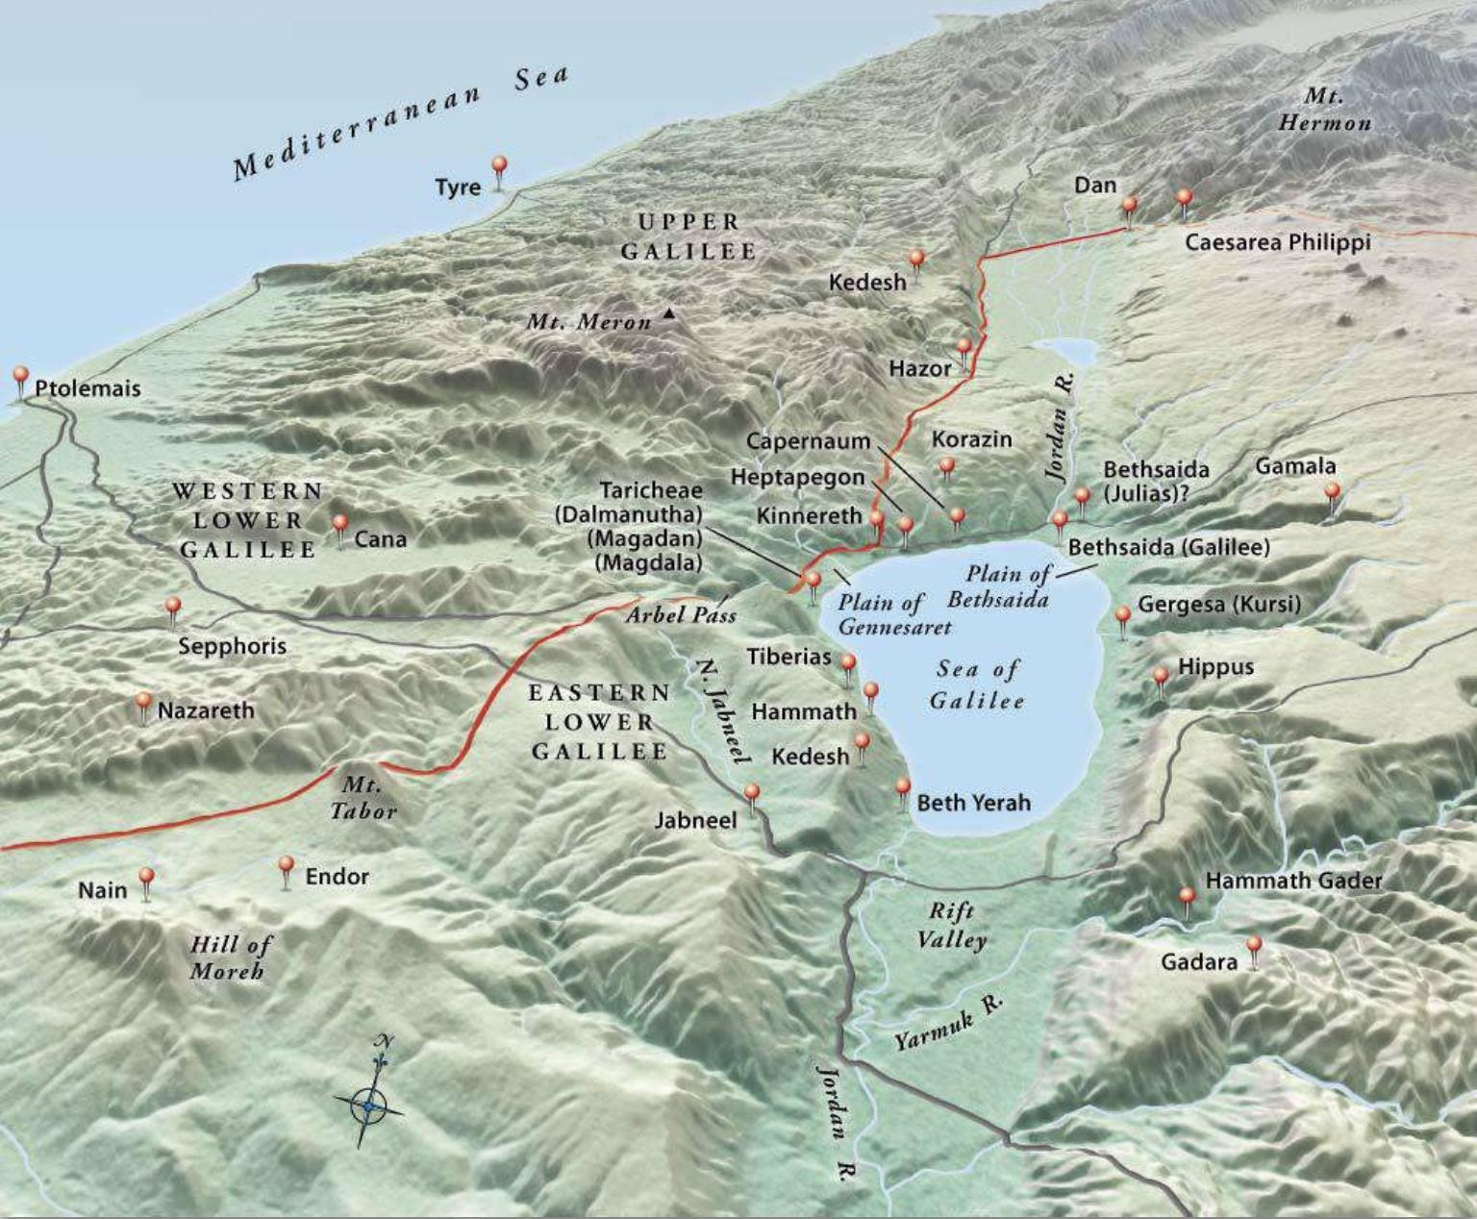
Topographical Map of Galilee (https://biblestudy.tips/bible-maps/)

